Slide 1
CSC 3210 Computer Organization and Programming Lab work 1
Dr. Zulkar Nine
Department of Computer Science
Georgia State University

Slide 2
Lab Work 1

Slide 3
Lab work 1 instructions
Lab 1(a) – Machine Setup and Microsoft Visual Studio installation (3 points)
Lab 1 (b) – Solve math problems (5 points)
Lab attendance – (2 points)
Due date – posted in iCollege.

Slide 4
Lab 1 (a)
Install Microsoft Visual Studio
Disclaimer: The process shown in these slides might not work in every single computer due to different Operating system versions, Microsoft Visual Studio versions and many other system level variabilities.
If you find any unusual error, you can inform the instructor.
Instructor will help you resolve the issue.

Slide 5
Lab 1(a) - Instructions
The Lab Teaching Assistant (TA) will demonstrate the installation process of Microsoft Visual Studio on both Windows and Mac machine.
Task: (3 points)
Install visual Studio Community 2019
Submission Instruction:
Complete the installation process of Microsoft Visual Studio 2019
Run Microsoft Visual Studio
Take a screenshot
Submit to the dropbox at iCollege

Slide 6
Lab 1 - Outline
Windows users –
Skip (Slide 8 to Slide 40)
Install Microsoft visual Studio (Slide 41 to Slide 50)
MacOS users -
Microsoft visual studio does not provide all libraries for Mac OS.
Don’t install “Microsoft Visual Studio for Mac” as doesn’t have all the libraries required for the course.
Setup a virtual machine that can run Windows Operating System on the MacOS
Follow Slide 8 to slide 40
Install Microsoft Visual Studio inside your windows virtual machine ( Side 41 to Slide 50)

Slide 7
Lab Attendance!

Slide 8
Virtual Machine Setup (Mac OS users only)
Windows users do not need to do this
Windows users must skip Slide 9 to 40

Slide 9
Outline – Virtual Machine Setup (MacOS users only)
Install Virtual Box in your Mac
Download Windows 10 ISO
Create a virtual machine (VM) in the Virtual Box
Install Windows 10 in the virtual machine
(You need at least 50GB free hard disk space, 60GB is recommended)
Please make sure that you have enough disk space
IF you have Mac computer with M1 processor, this process might not work for you. In that case, contact the instructor.

Slide 10
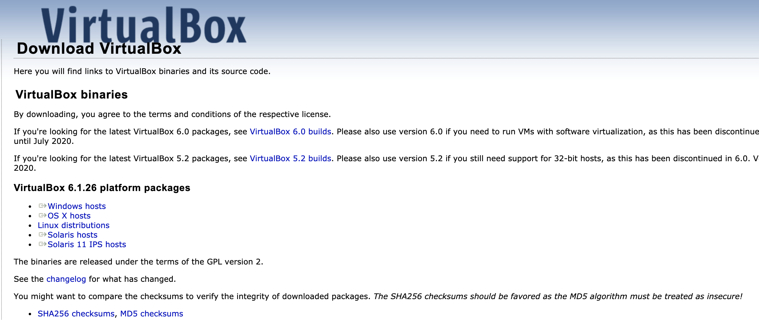
Install VirtualBox
Go to https://www.virtualbox.org/wiki/Downloads
Download and Install the software
Download the package

Slide 11
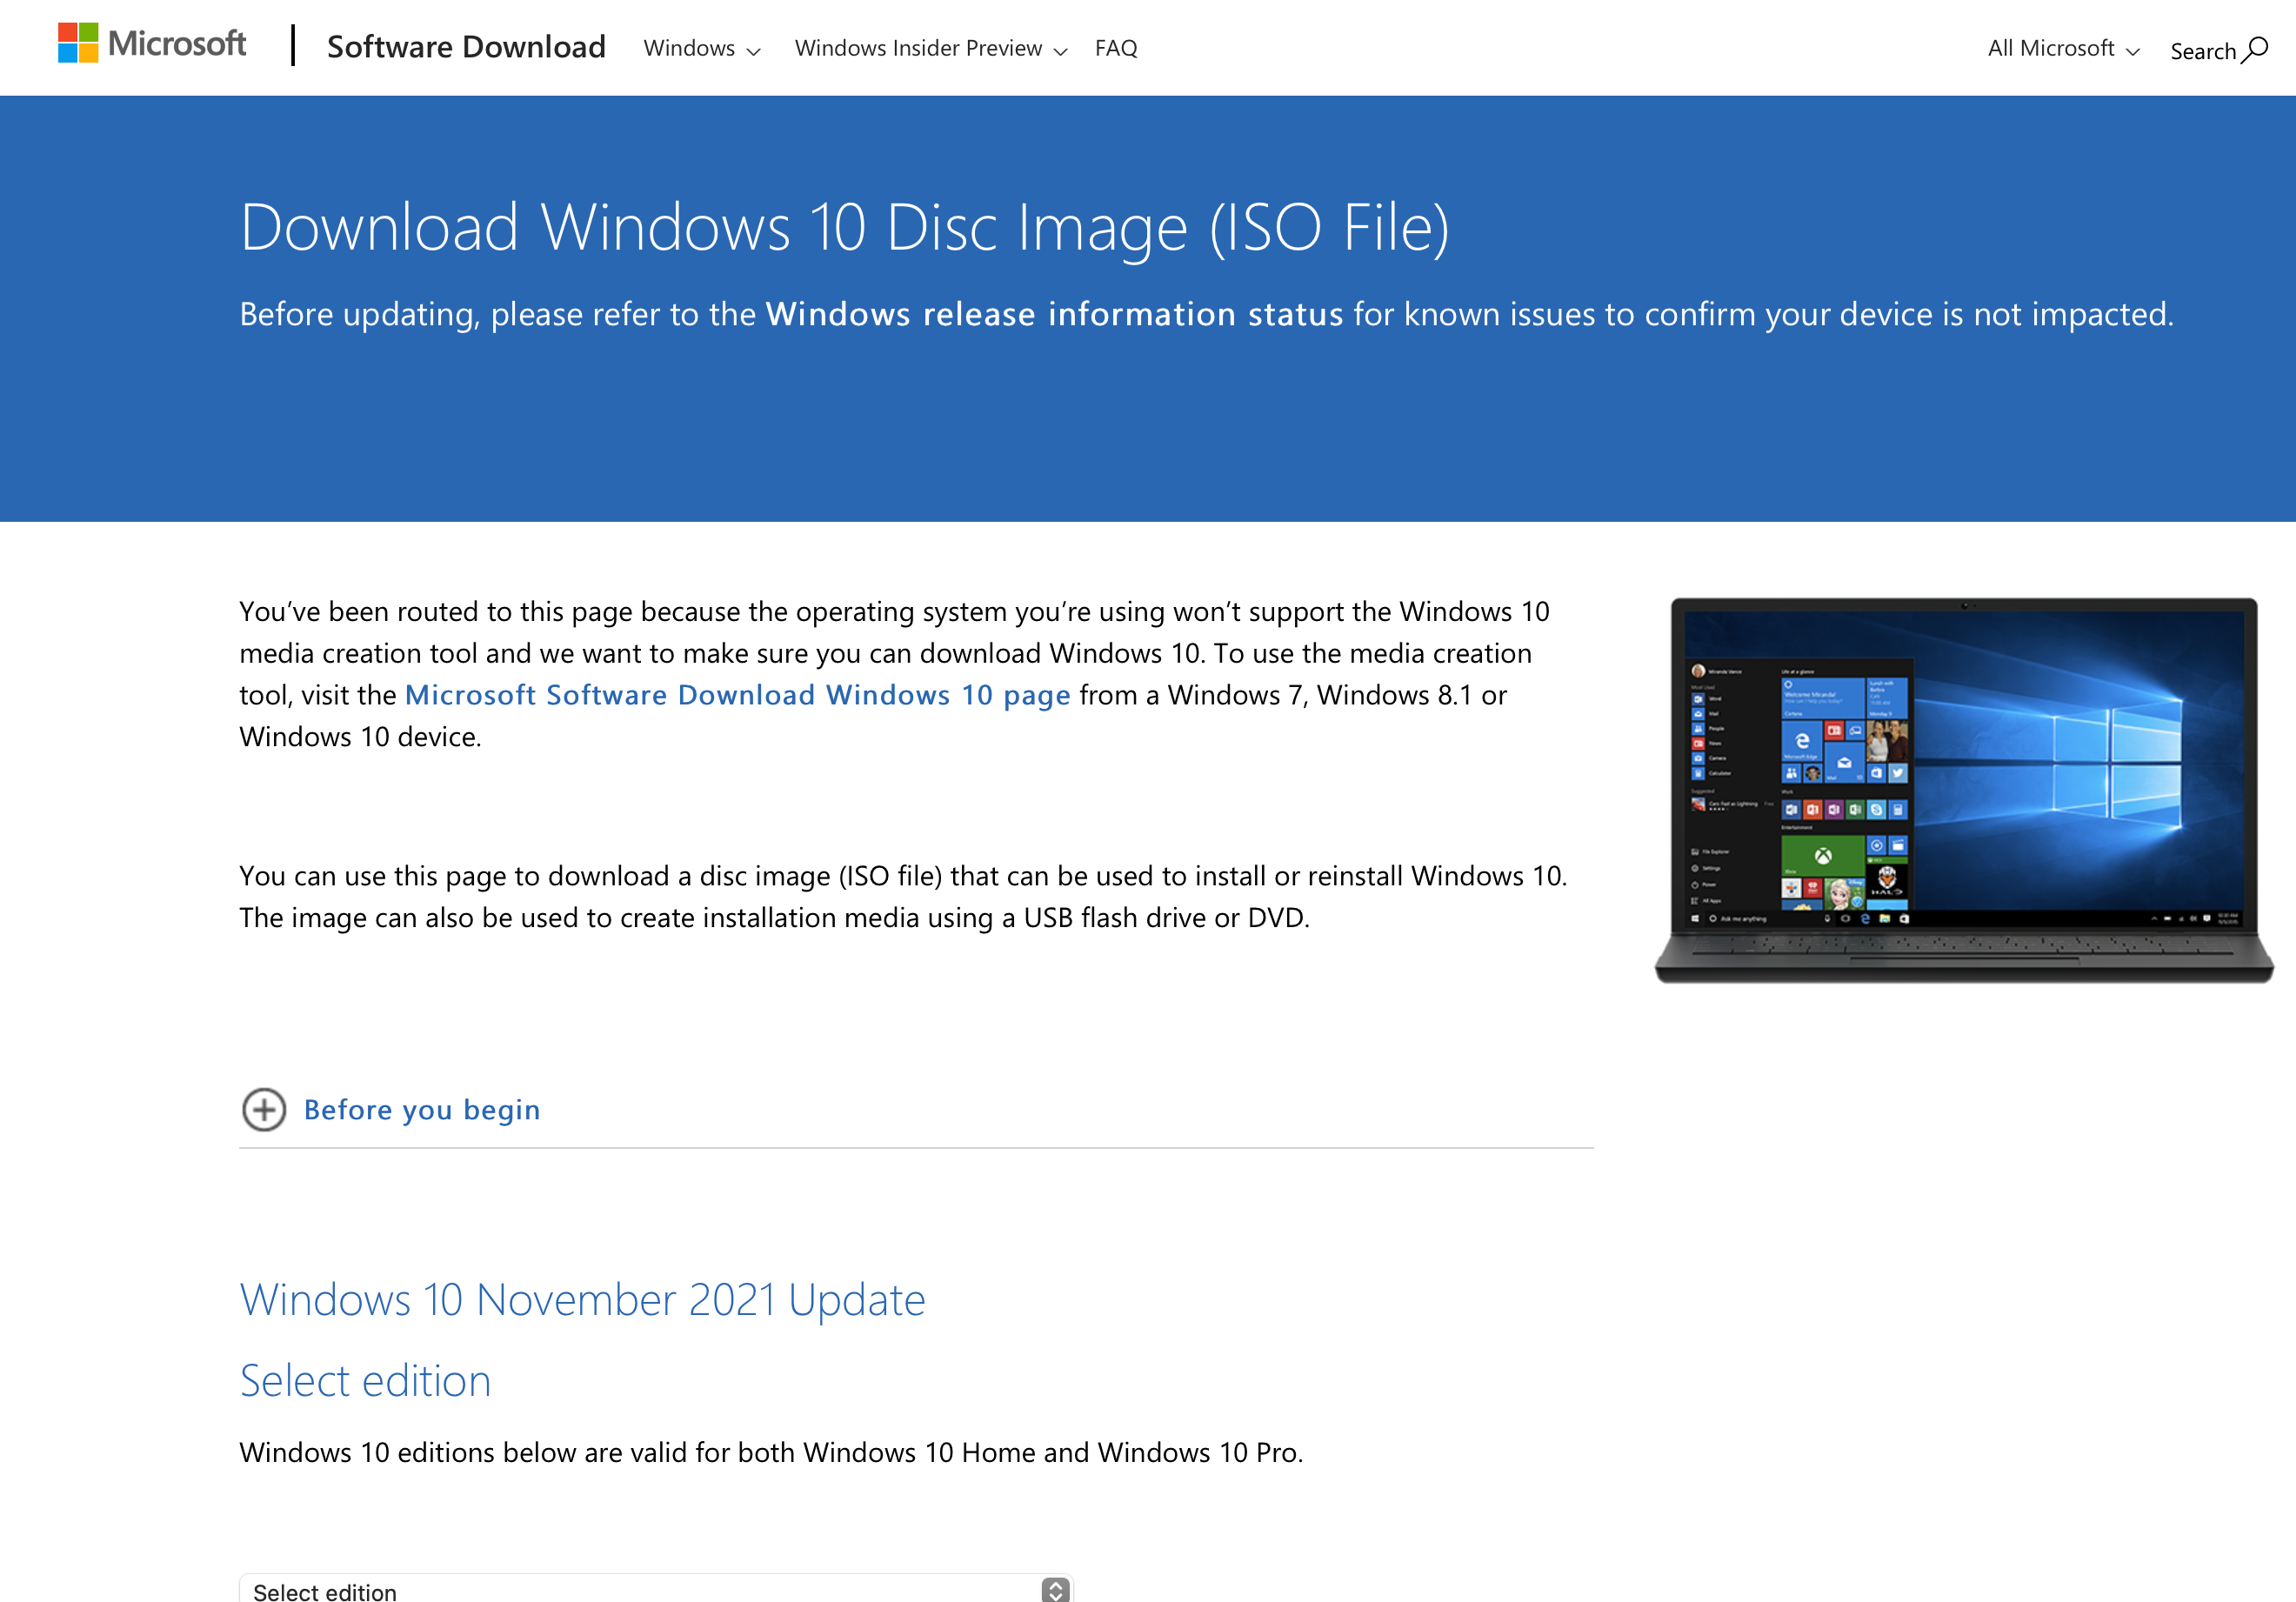
Download Windows 10 ISO (1)
Go to :
https://www.microsoft.com/en-us/software-download/windows10ISO

Slide 12
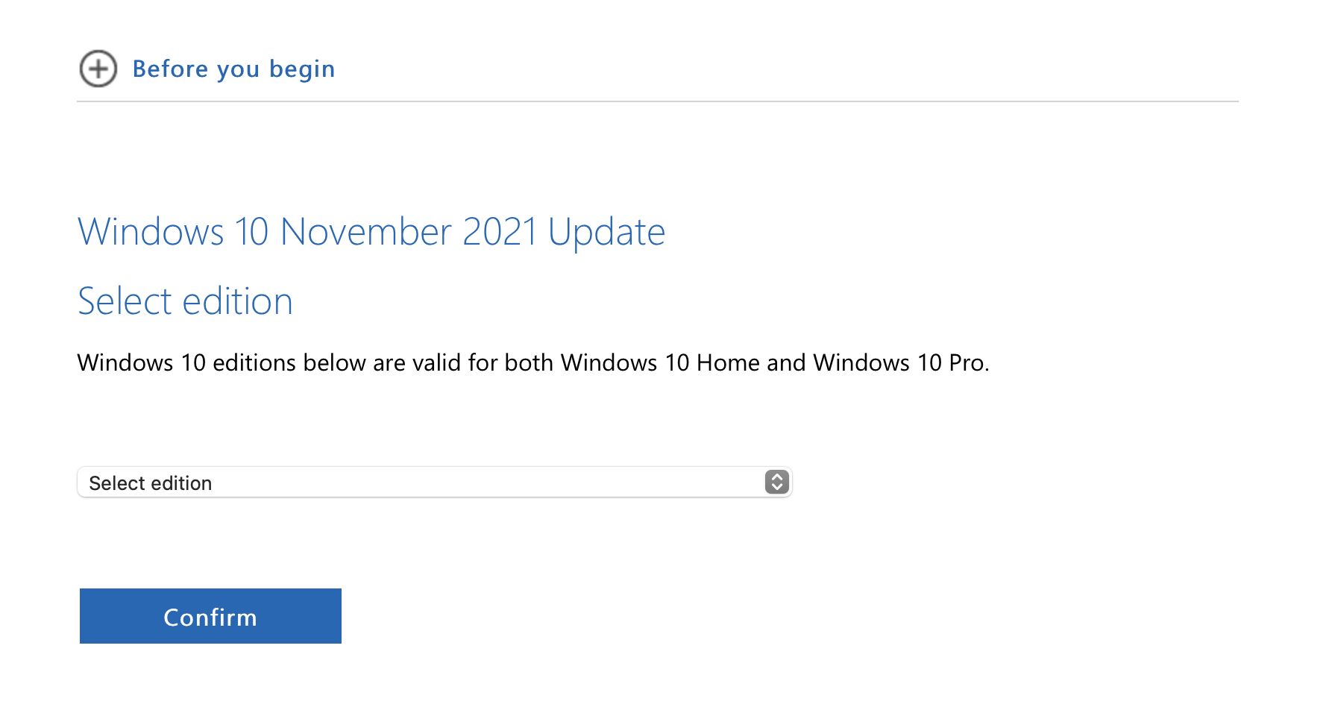
Download Windows 10 ISO (2)
Select “Windows 10 Multi-edition ISO”

Slide 13
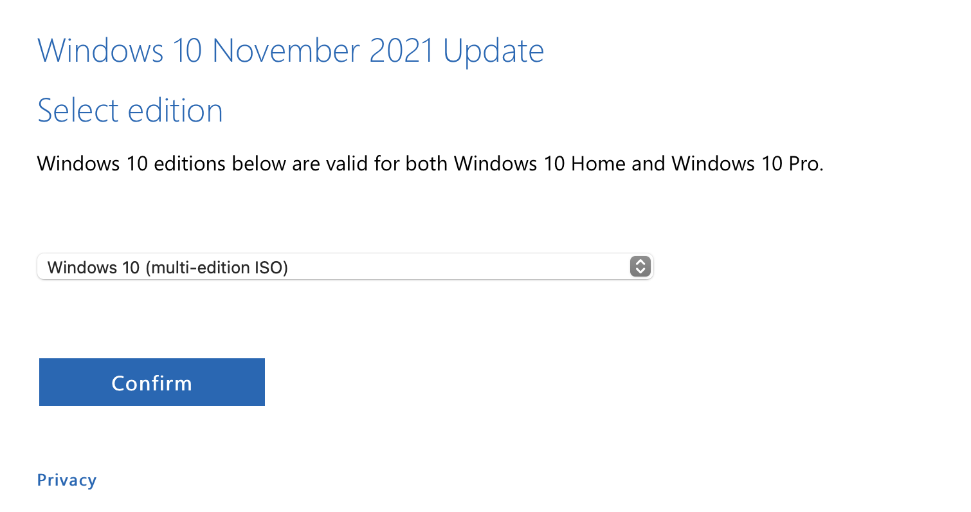
Download Windows 10 ISO (3)
Click Confirm

Slide 14
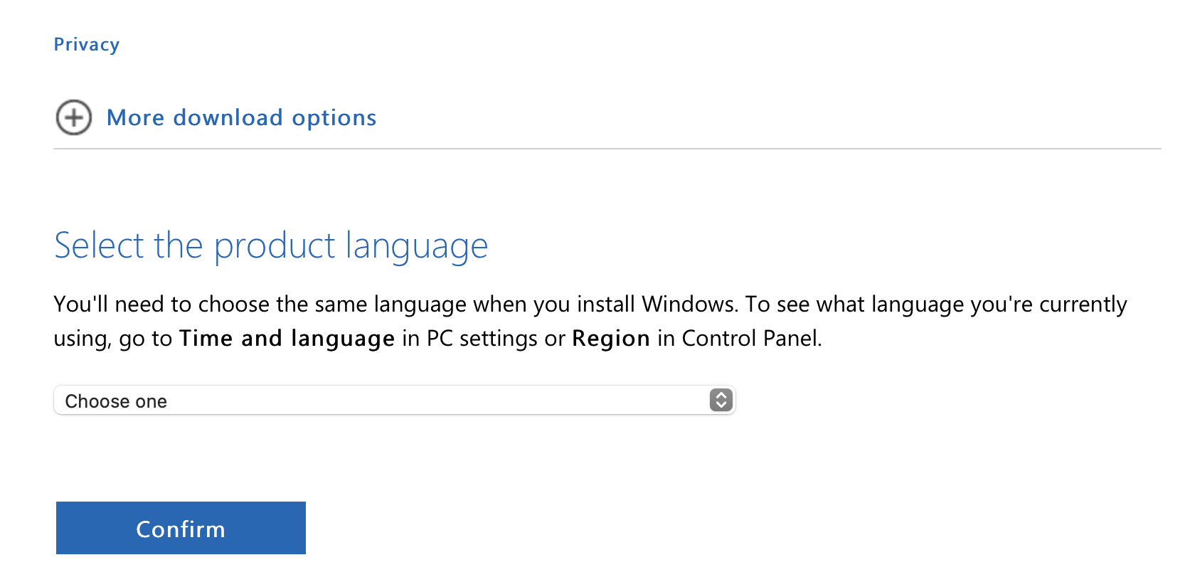
Download Windows 10 ISO (4)
Select “English”
And click “Confirm”

Slide 15
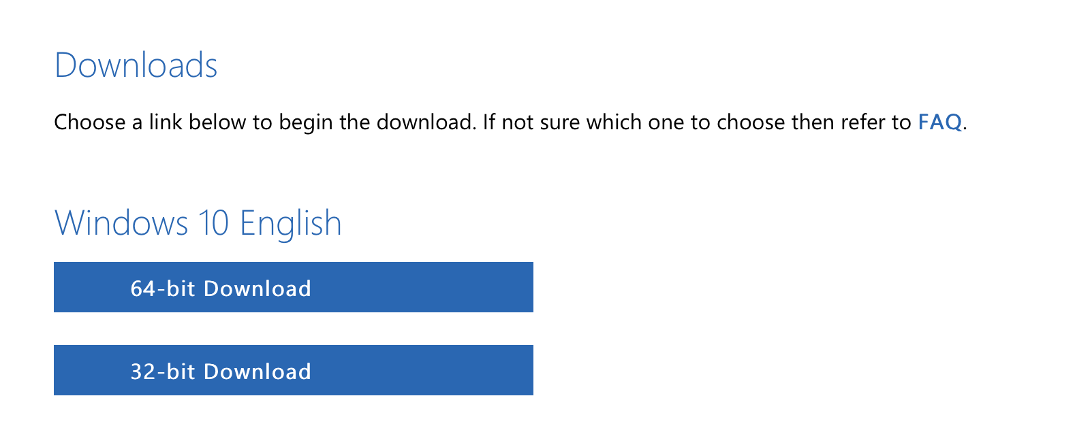
Download Windows 10 ISO (5)
Download 64-bit Windows

Slide 16
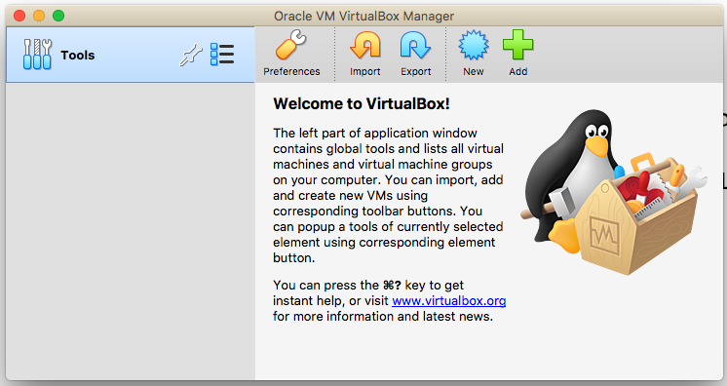
Create a virtual machine (1)
Create a new Virtual Machine
Open the Virtual box

Slide 17
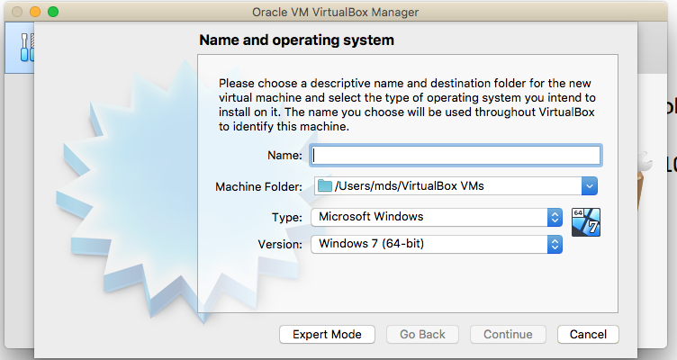
Create a virtual machine (2)
Make sure the “Type” is set to Microsoft Windows
And the version windows 10
64 bit means a 64 bit VM
X86 means a 32 bit VM.

Slide 18
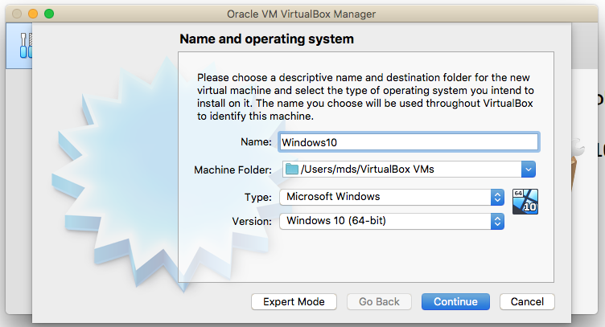
Create a virtual machine (3)
Name your VM
Make sure it is
Windows 10

Slide 19
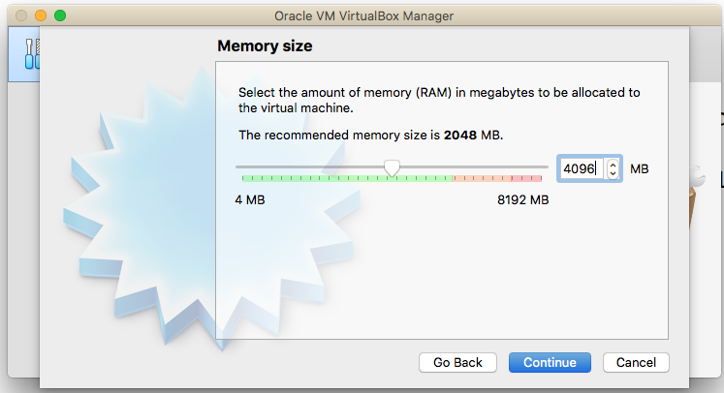
Create a virtual machine (4)
Select memory size
(4GB or more)

Slide 20
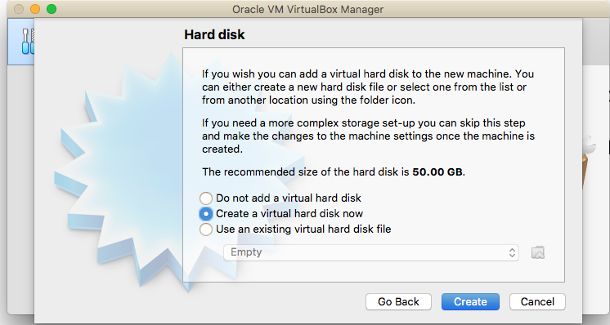
Create a virtual machine (5)
(1)Create a virtual hard disk of size at least 50 GB.
60GB is recommended.
Make sure that you have enough space in the hard drive
(2) Click Create

Slide 21
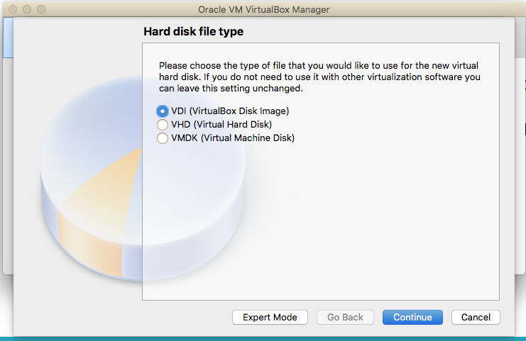
Create a virtual machine (6)
Click Continue

Slide 22
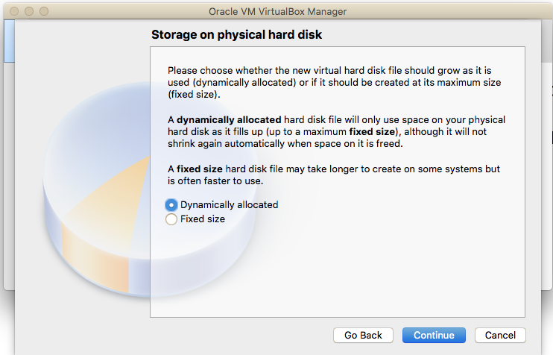
Create a virtual machine (7)
Click Continue

Slide 23
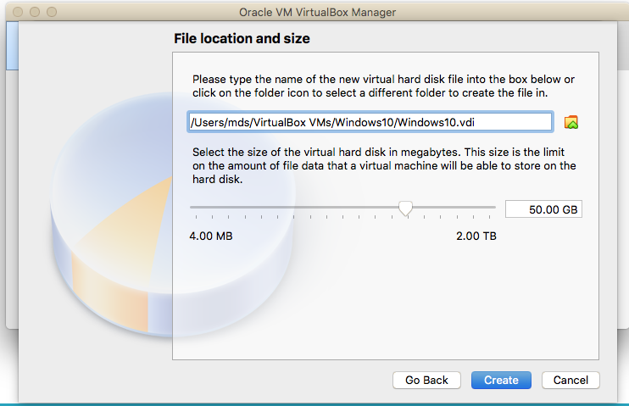
Create a virtual machine (8)
Click Continue

Slide 24
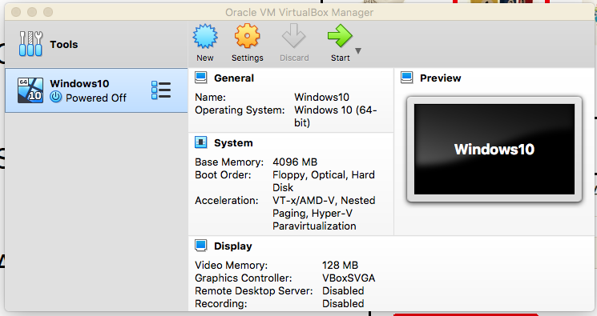
Install Windows 10 in VM (1)
Click on settings

Slide 25
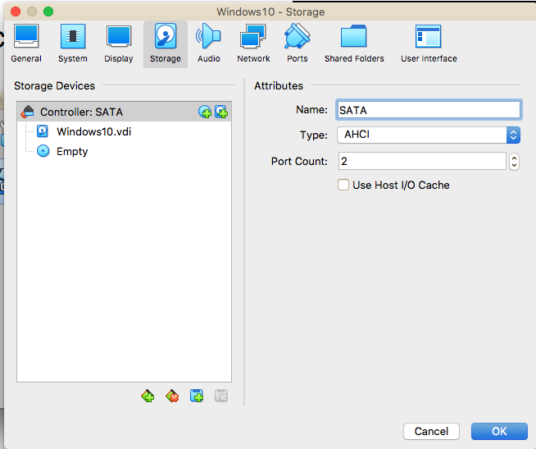
Install Windows 10 in VM (2)
(1) Select storage
(2) Click the disk icon
Note : Here you load the windows iso file

Slide 26
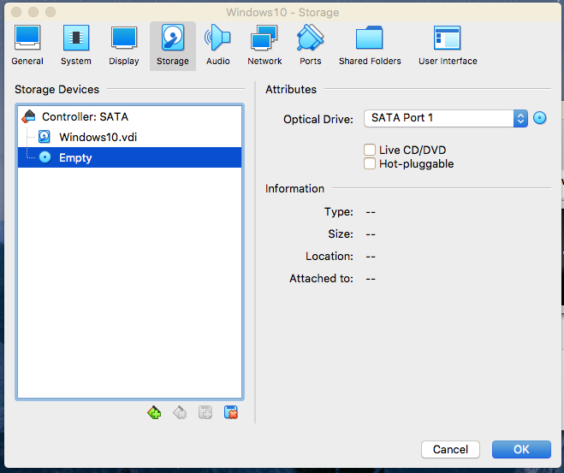
Install Windows 10 in VM (3)
Click the disk icon
Note: It will show you options to load Windows ISO file.

Slide 27
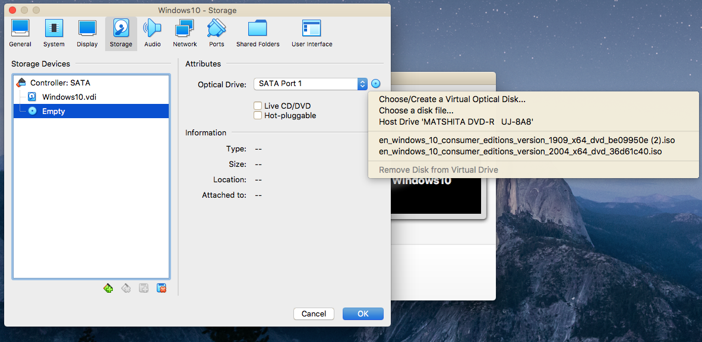
Install Windows 10 in VM (4)
Select the ISO file from the directory

Slide 28
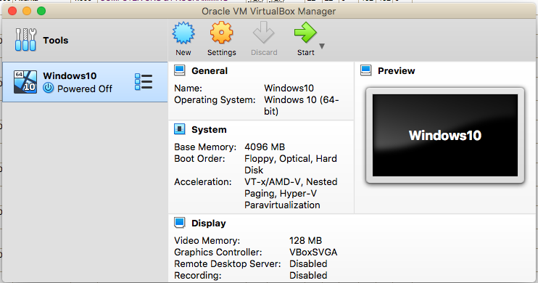
Install Windows 10 in VM (5)
Click settings
Note : Check the boot order

Slide 29
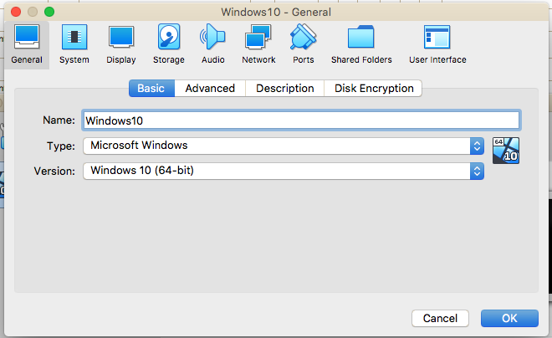
Install Windows 10 in VM (6)
Click System

Slide 30
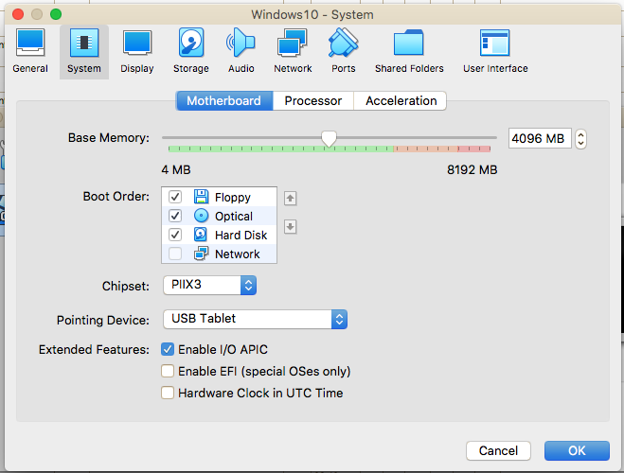
Install Windows 10 in VM (7)
Boot order should be like this.
If it is not like this, change the order by clicking the arrow signs (up, down) right to the list.

Slide 31
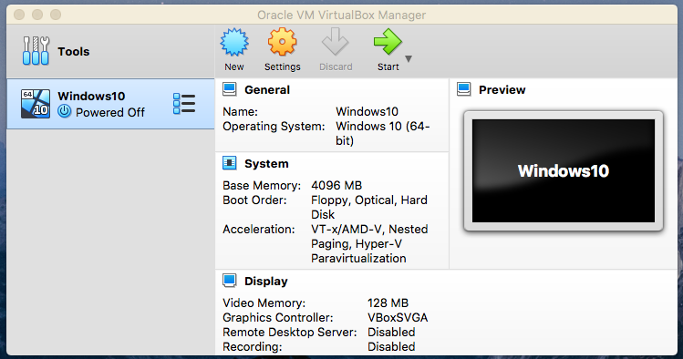
Install Windows 10 in VM (8)
Start the Virtual machine

Slide 32
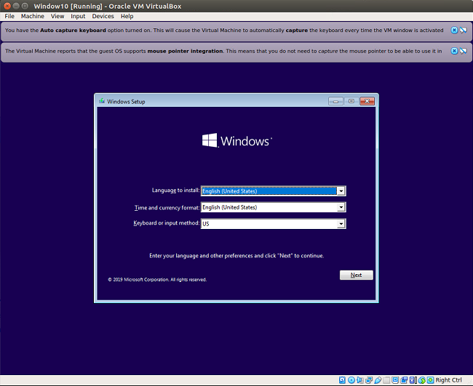
Install Windows 10 in VM (9)
Click Next

Slide 33
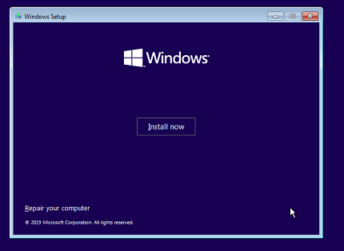
Install Windows 10 in VM (10)
Click Install now

Slide 34
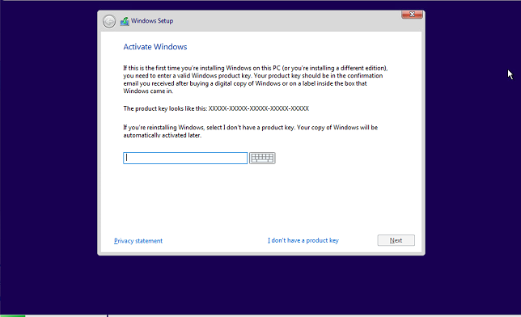
Install Windows 10 in VM (11)
Click on “I don’t have a product key”
Then click “Next”

Slide 35
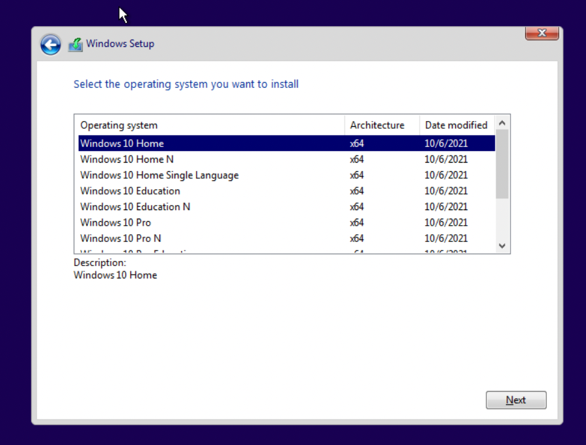
Install Windows 10 in VM (12)
Select “Windows 10 Education N”
Click “Next”

Slide 36
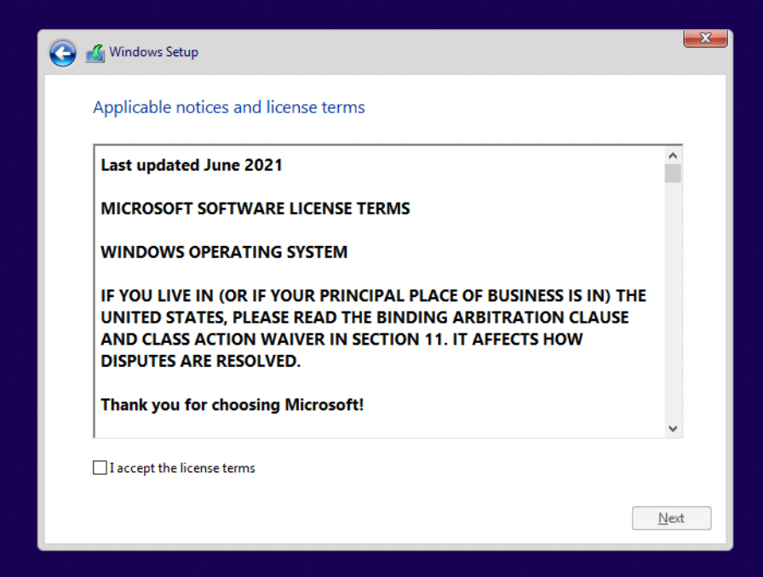
Install Windows 10 in VM (13)
Accept the license terms.
Click “Next”

Slide 37
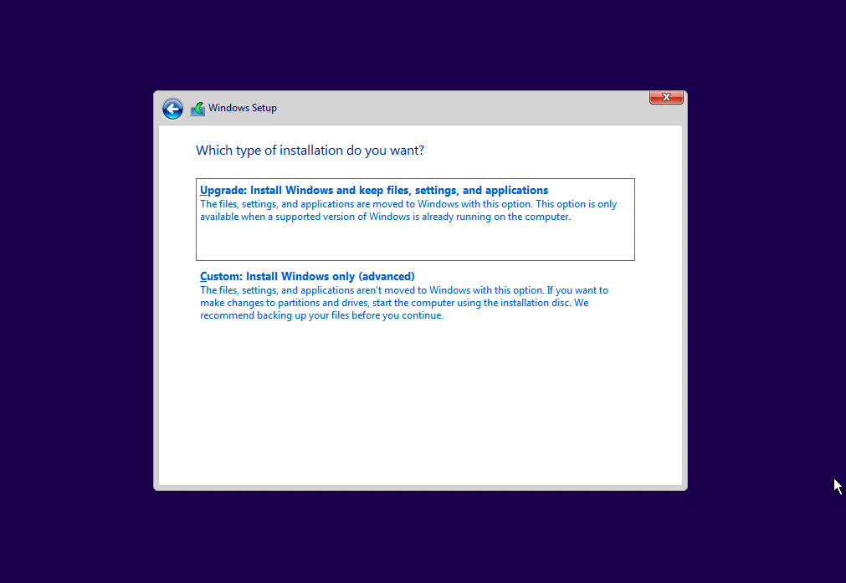
Install Windows 10 in VM (14)
Select custom installation
Then click next to start installation

Slide 38
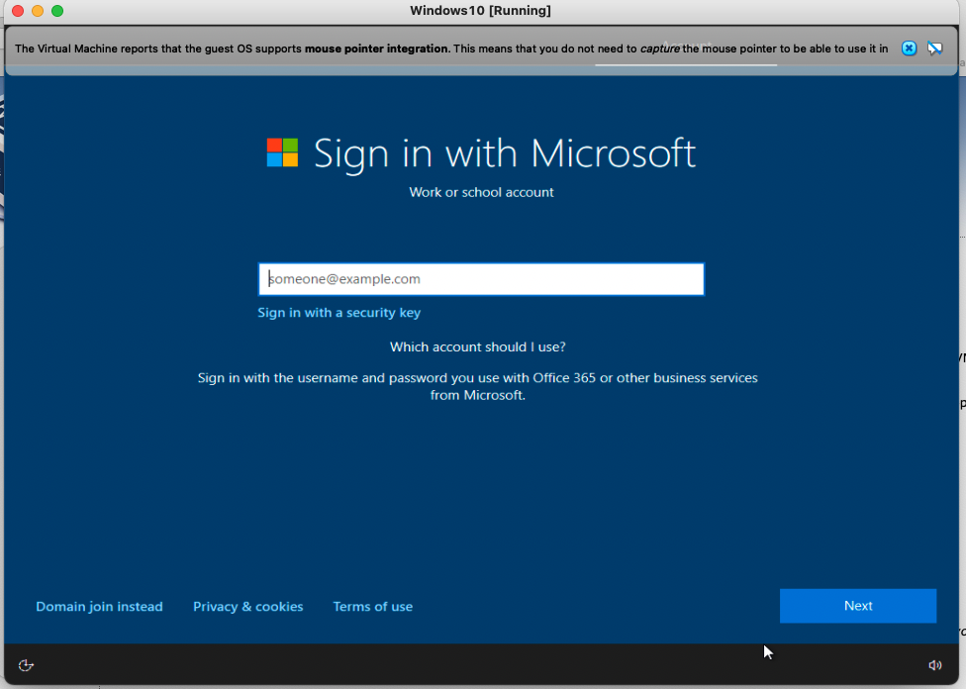
Install Windows 10 in VM (15)
After the installation system will reboot.
Try to login using university credentials (school email and password)

Slide 39
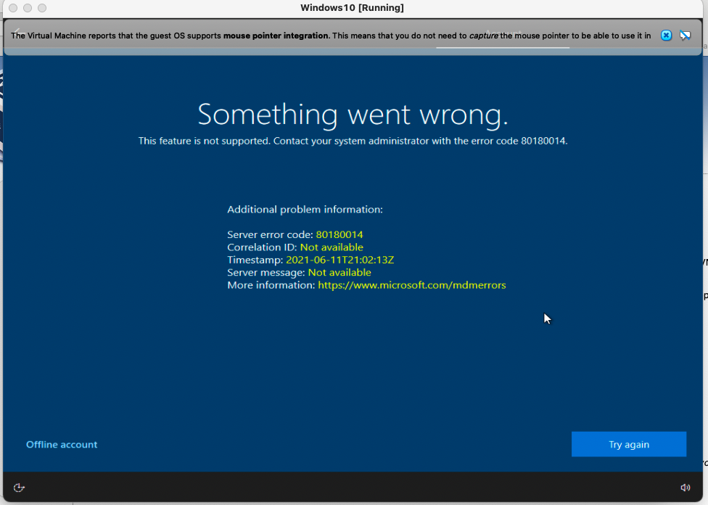
Install Windows 10 in VM (16)
If the following error screen appears create an offline account, using the offline account option on the lower left corner

Slide 40
Optional Software installation in Windows VM
Install Guest Additions
Follow the instructions provided in the link below.
https://pureinfotech.com/install-guest-additions-windows-10-virtualbox/

Slide 41
Install Microsoft Visual Studio
Both Windows and Mac OS users
(Mac users need to install Microsoft visual studio on the windows Virtual machine.)

Slide 42
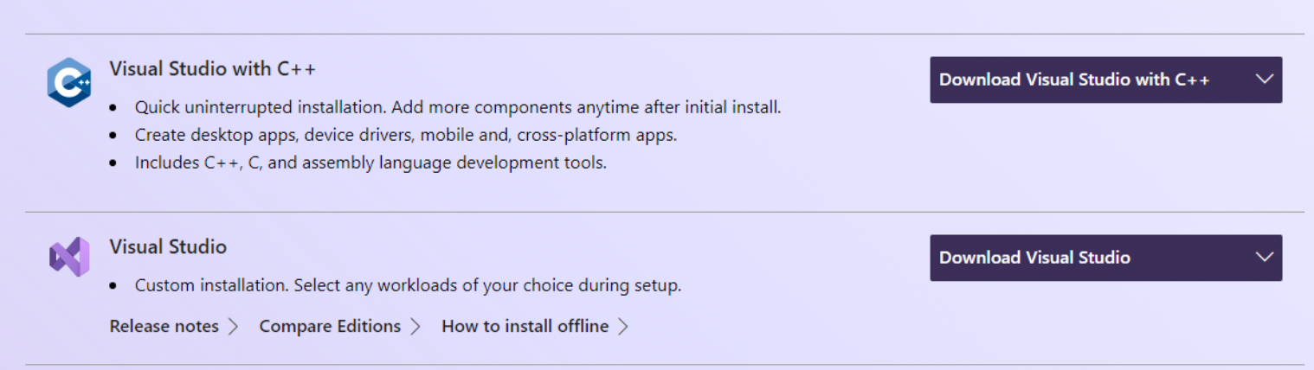
Visual Studio Setup
Go to : https://visualstudio.microsoft.com/downloads/
Expand the arrow

Slide 43
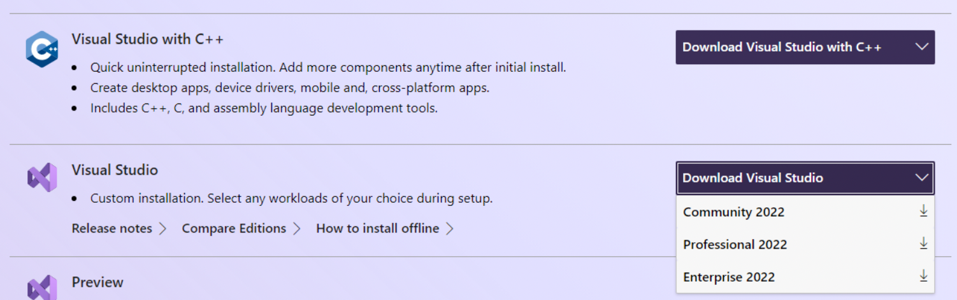
Visual Studio setup
Download community 2022 edition

Slide 44
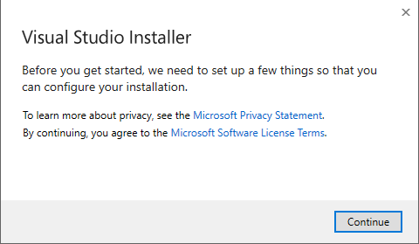
Visual Studio Setup
Double Click the installer
Click Continue button
Click Continue

Slide 45
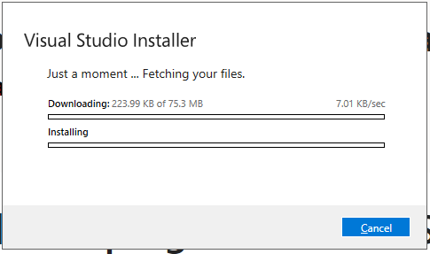
Visual Studio Setup
It will start downloading files

Slide 46
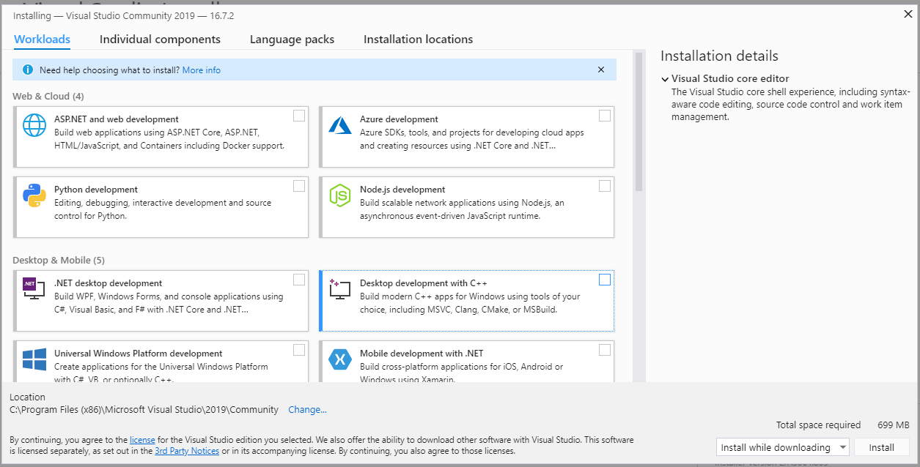
Visual Studio Setup
Check mark both .Net Desktop development and Desktop development with C++

Slide 47
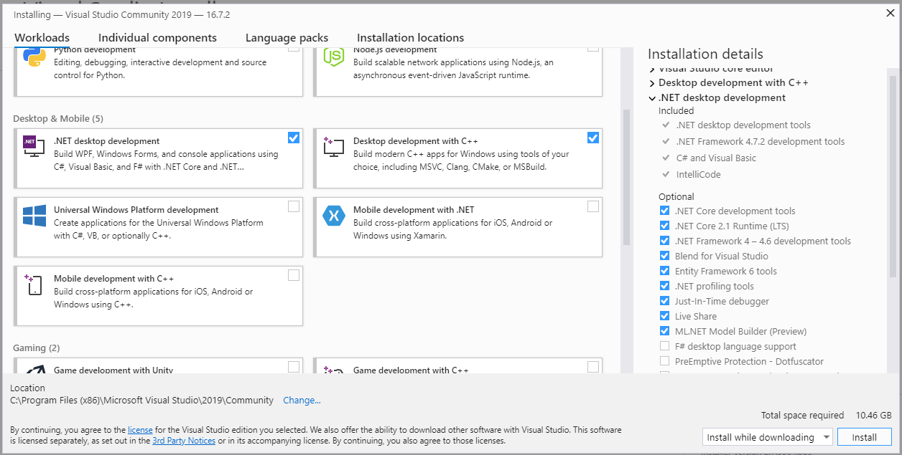
Visual Studio Setup
Click install

Slide 48
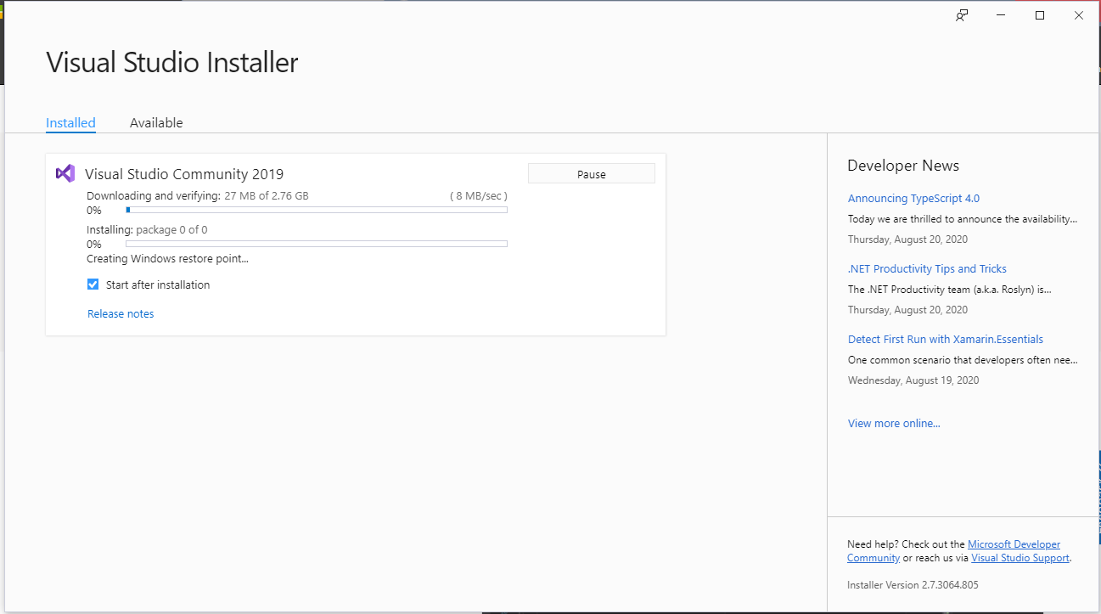
Visual Studio Setup
It will take some time to download the files, depending on your internet speed.

Slide 49
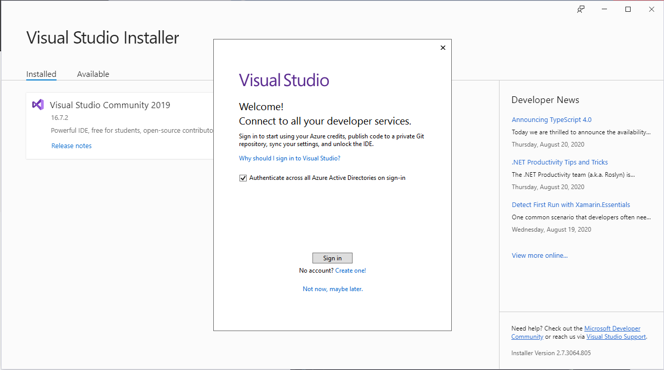
Visual Studio Setup
Sign in with your Microsoft account
Username
Password

Slide 50
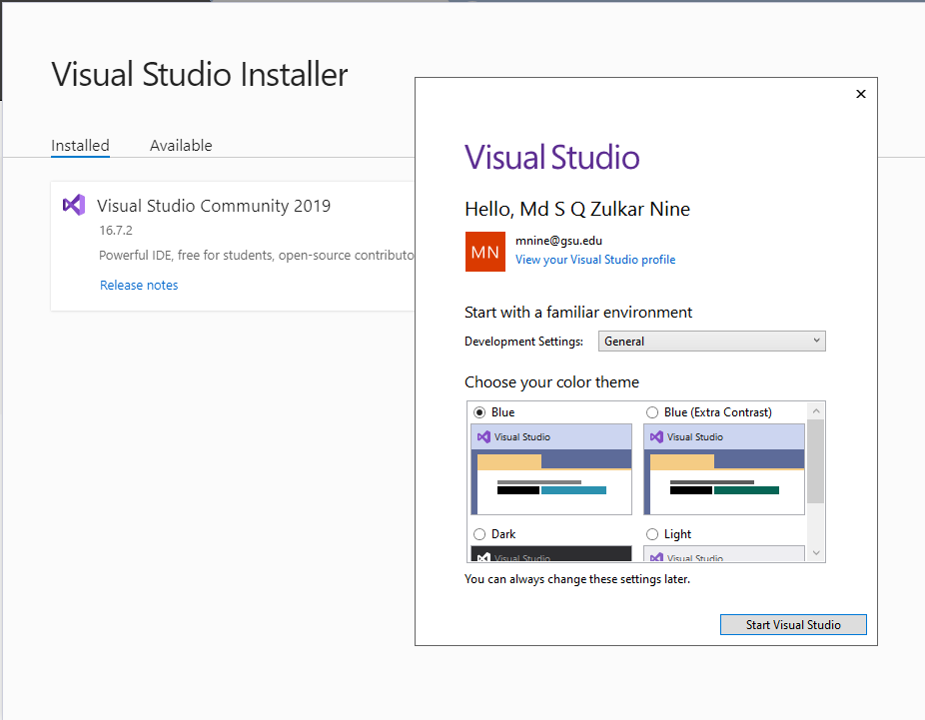
Visual Studio Setup
Start visual Studio

Slide 51
Some Math Recap …

Slide 52
Examples
Binary | Hex
0000 | 0
0001 | 1
0010 | 2
0011 | 3
0100 | 4
0101 | 5
0110 | 6
0111 | 7
1000 | 8
1001 | 9
1010 | A
1011 | B
1100 | C
1101 | D
1110 | E
1111 | F
Example 1: Convert Binary to Hexadecimal
Convert 10010010110101 to Hex
Solution:
1) Segment bits as a group of 4 bits from the right side.
10 0100 1011 0101
2) Pad with 0’s when the left most group doesn’t have 4 bits
3) Convert each group into hexadecimal digits using
the table : 24B5
0010 | 0100 | 1011 | 0101

Slide 53
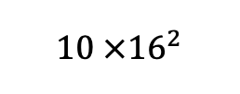
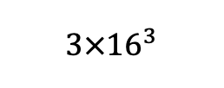
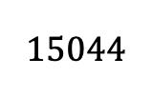
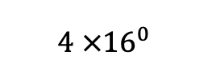
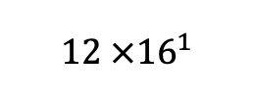
Examples
Example 2: Convert Hexadecimal to Decimal
Convert 3AC4 to decimal
Solution:
3 A C 4
$3×{16}^{3}$
+
$10 ×{16}^{2}$
+
+
=
$15044$
$12 ×{16}^{1}$
$4 ×{16}^{0}$

Slide 54
Examples
Example 3: Convert the following number into two’s compliment form.
Convert 00010110 into 2’s Complement form
Solution:
Flip all the bits (0 to 1, 1 to 0)
11101001 (This is 1’s complement)
2) Add 1 to the 1’s complement
11101001
+ 1
11101010 (This is 2’s complement)

Slide 55

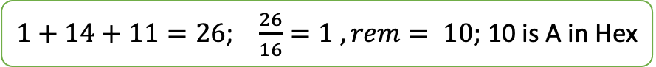







Examples
Example 4: Hexadecimal Addition
3AE8 + 9FBA = ?
carry 1 1 1
3 A E 8
2 F B A
6 A A 2
$8+10=18$; $\frac{18}{16}=1 , rem 2$
$1+14+11=26$; $\frac{26}{16}=1 , rem= 10;$ 10 is A in Hex
$1+10+15=26$; $\frac{26}{16}=1 , rem=10;$ 10 is A in Hex
$1+3+2=6$; 6 is 6 in Hex

Slide 56
Examples
Binary | Octal
000 | 0
001 | 1
010 | 2
011 | 3
100 | 4
101 | 5
110 | 6
111 | 7
Example 1: Convert Binary to Octal
Convert 10100011101 to Octal
Solution:
1) Segment bits as a group of 3 bits from the right side.
10 0100 1011 0101
2) Pad with 0’s when the left most group doesn’t have 4 bits
3) Convert each group into Octal digits using
the table : 2 4 3 5
010 | 100 | 011 | 101

Slide 57
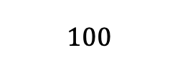
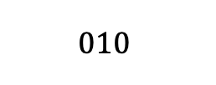
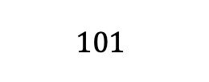

Example : Octal to Binary Conversion
Binary | Octal
000 | 0
001 | 1
010 | 2
011 | 3
100 | 4
101 | 5
110 | 6
111 | 7
Convert 2435 to Binary
2 4 3 5
$$010$$
$$100$$
$$011$$
$$101$$

Slide 58

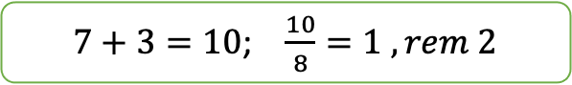

Octal addition
Add two octal numbers :
567 + 123 = ?
Carry. 1 1
5 6 7
1 2 3
7 1 2
$7+3=10$; $\frac{10}{8}=1 , rem 2$
$1+6+2=9$; $\frac{9}{8}=1 , rem 1$
$1+5+1=7$;

Slide 59
Practice at home
Number conversion among binary, hexadecimal, octal
Addition, subtraction different number systems.

Slide 60
Lab 1 (b) : Basic Concepts
Submission instructions

Slide 61
Lab 1 (b) : Submission
Solve the Problems provided in slide 57 to 59.
You can do your work in a text editor (Microsoft word, open office, etc.)
Or you can do it in a piece of paper, then scan or take a picture of the paper.
Convert them into pdf and submit in the icollege.

Slide 62
Lab 1 (b): Problem 1
Subtract the following hexadecimal numbers
7ACD - 3AFE = ?
Show the computation in details with all the carries. Result should be Hexadecimal

Slide 63
Lab 1 (b) Problem 2
Convert 01110110 into 2’s Complement form.

Slide 64
Lab 1 (b) Problem 3
Subtract the following Octal numbers
765 – 377
Show the steps with carries. Result is a octal number

